Slide 1
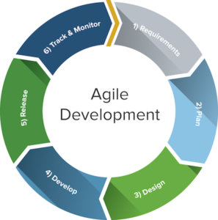
Agile Model

Slide 2
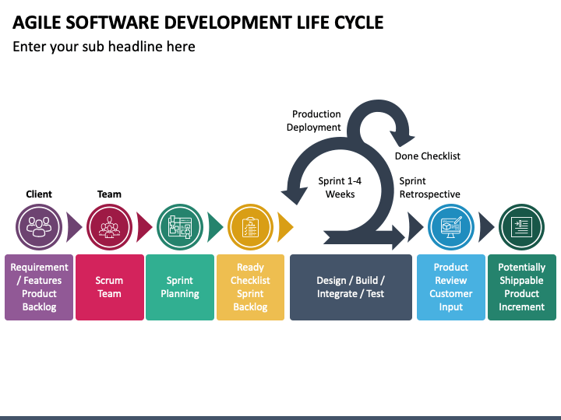
Agile project will be broken down into several sprints, each sprint taking the project closer to completion.
a short, time-boxed period when a scrum team works to complete a set amount of work

Slide 3


An Agile View of Process
Agile-Quick moving, nimble(light), active
Agile software engineering-
Developed to overcome drawbacks of conventional s/w engg.
Not applicable to all projects, products, people and situations.
Philosophy
+
set of development guidelines.

Slide 4
Philosophy:
customer satisfaction and early incremental delivery of s/w;
small, highly motivated project teams;
informal methods;
minimal s/w engg work products;
overall development simplicity.
set of development guidelines:
stress delivery over analysis and design.
active and continuous communication b/n developers and customers.

Slide 5
Who does it?
S/w engineers and other project stakeholders (managers, customers, end-users)
Why is it important?
fast-paced.
ever-changing.
alternative to conventional s/w engg.
delivers successful systems quickly.
Also known as "software engineering lite”.

Slide 6
How do we ensure that we've done it right?
If the agile team agrees that the process works and the team produces deliverable s/w increments that satisfy the customer, we've done it right.
Agility: An agile team is a nimble team able to appropriately respond to changes
Changes in the s/w being built,
Changes to the team members,
Changes because of new technology,
Changes in project that creates product.
Agility is dynamic, content specific, aggressively change embracing, and growth oriented.

Slide 7
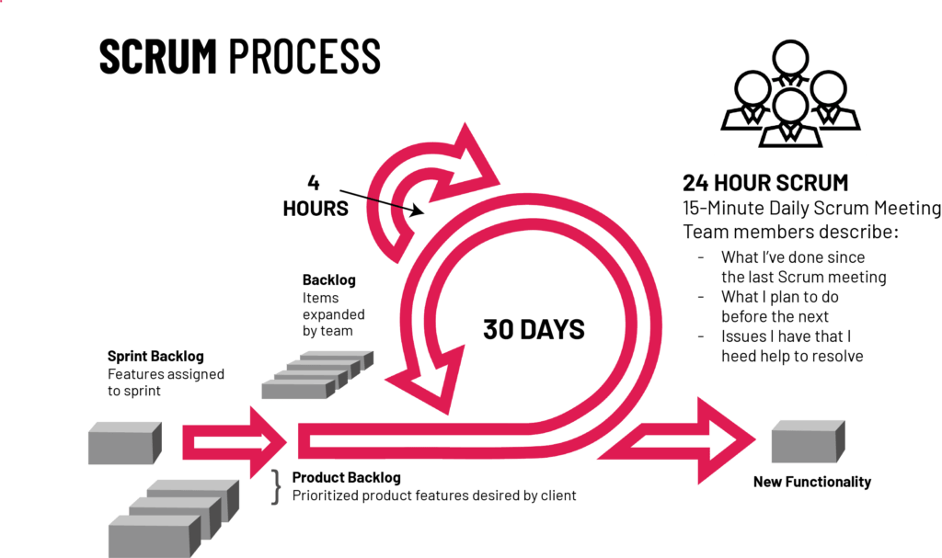
Scrum is an agile project management framework that helps teams' structure and manage their work through a set of values, principles, and practices.

Slide 8
Philips
Philips is another firm that has adopted Agile principles. After numerous changes to management structure, the firm introduced several Agile coaches that went to deploy
Scrum principles such as Scrum boards and breaking down teams into smaller ones.
As a result of changes like this, teams could react to situations quicker, bureaucracy was removed, and it was ultimately easier for these smaller teams to take responsibility for their respective products.

Slide 9
JP Morgan Chase
Another banking institution that needs no introduction is JP Morgan Chase. A few years ago, the baking giant overhauled their business processes to help improve product development and simultaneously slashed the cost of training as part of a high-profile IT initiative. Agile methodologies were a key part of the initiative.
The initiative involved the extensive redevelopment of key platforms, and in some instances, multiple legacy systems.

Slide 10
Why Agile Matters in Industry
Faster delivery
Better customer feedback loop
More adaptive to change
Notes:
Key principles: individuals/interactions, working software, customer collaboration, responding to change

Slide 11
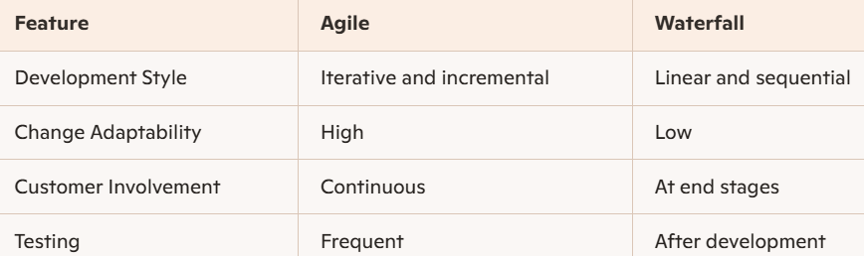
Agile vs. Traditional Models

Slide 12
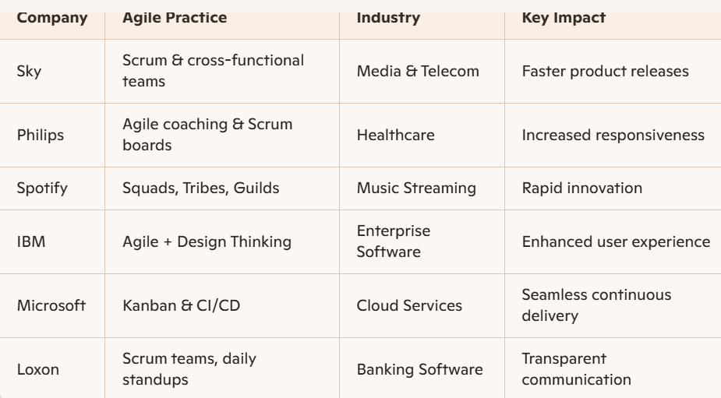
Case Studies of Agile in real-time

Slide 13
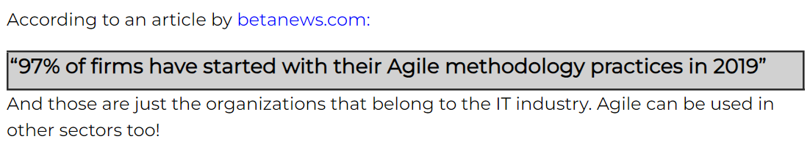

Slide 14
12 principles for those who want to achieve agility:
Our highest priority is to satisfy the customer through early and continuous delivery of valuable software.
welcome changing requirements, even late in development phase. Agile processes support changes for the customer's advantage.
Deliver working s/w frequently, from a couple of weeks to a couple of months, with a preference to the shorter timescale.

Slide 15
12 principles for those who want to achieve agility:
4. Business people and developers must work together daily throughout the project.
5. Build projects around motivated individuals. Give them the environment and support they need, and trust them to get the job done.
6. The most efficient and effective method of conveying information to and within a development team is face-to-face conversation.

Slide 16
12 principles for those who want to achieve agility:
Working s/w is the primary measure of progress.
8. Agile processes promote sustainable development. The sponsors, developers, and users should be able to maintain a constant pace indefinitely.
9. Continuous attention to technical excellence and good design enhances agility.

Slide 17
12 principles for those who want to achieve agility:
10. Simplicity is essential.
11 . The best architectures, requirements, and designs emerge from self-organizing teams.
12. At regular intervals, the team reflects on how to become more effective, then tunes and adjusts its behavior accordingly.

Slide 18
What Is an Agile Process?
Agile software process three key assumptions.
1 . It is difficult to predict in advance which s/w requirements will persist and which will change. It is equally difficult to predict how customer priorities will change as a project proceeds.
For many types of s/w, design and construction are interleaved and It is difficult to predict how much design is necessary before construction is used to prove the design.
Analysis, design, construction, and testing are not as predictable as we might like.

Slide 19
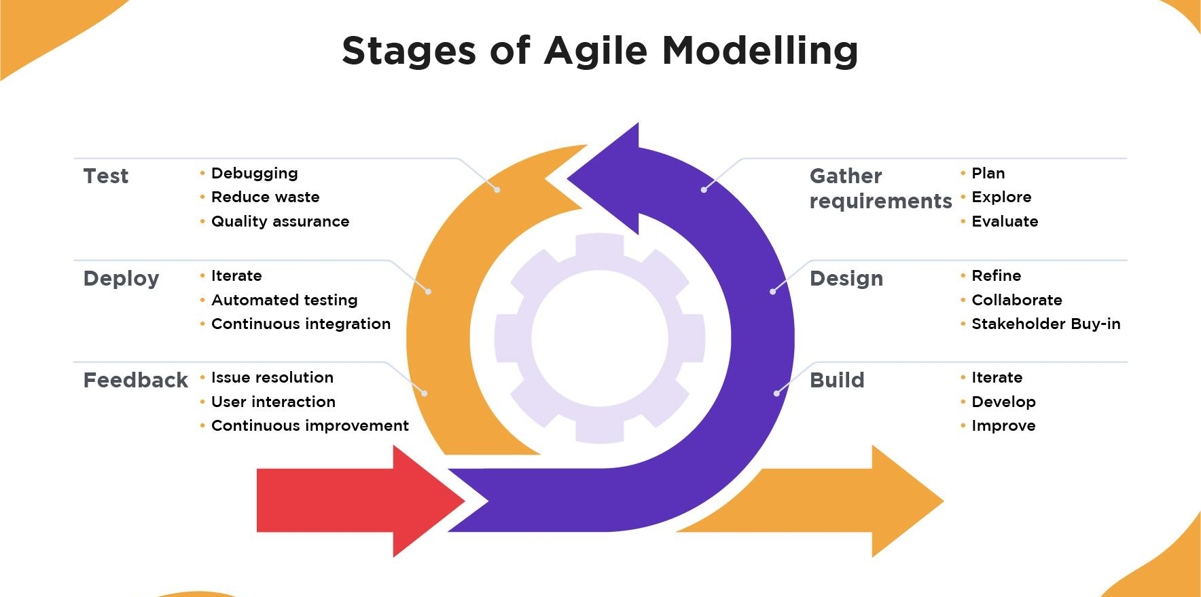

Slide 20
Agile Process Models:
1.Extreme Programming(XP)
2.Adaptive s/w Development(ASD)
3.Dynamic s/w Development Method(DSDM) 4.Scrum
Crystal
Feature Driven Development(FDD)
7.Agile modeling(AM)

Slide 21
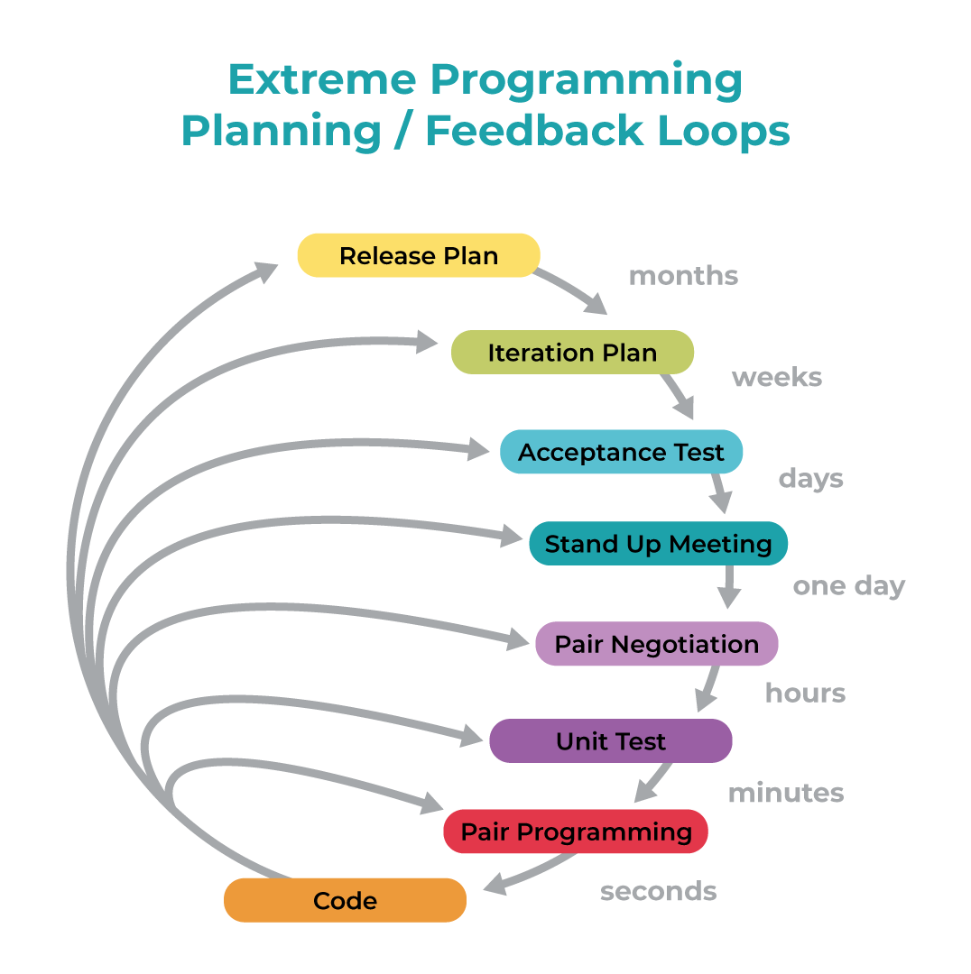
I. Extreme Programming (XP)
most widely used agile process, originally proposed by Kent Beck
Uses an object-oriented approach.
Describes a set of rules for framework activities:
planning,
design,
coding, and
testing.

Slide 22
XP Planning
-Begins with the creation of user stories.
-Agile team assesses each story and assigns a cost.
-Stories are grouped to for a deliverable increment.
-A commitment (agreement on stories to be included, delivery date, and other project matters) is made on delivery date.
-After the first increment project velocity (no. of customer stories implemented during the first release) is used to help define subsequent delivery dates for other increments.

Slide 23
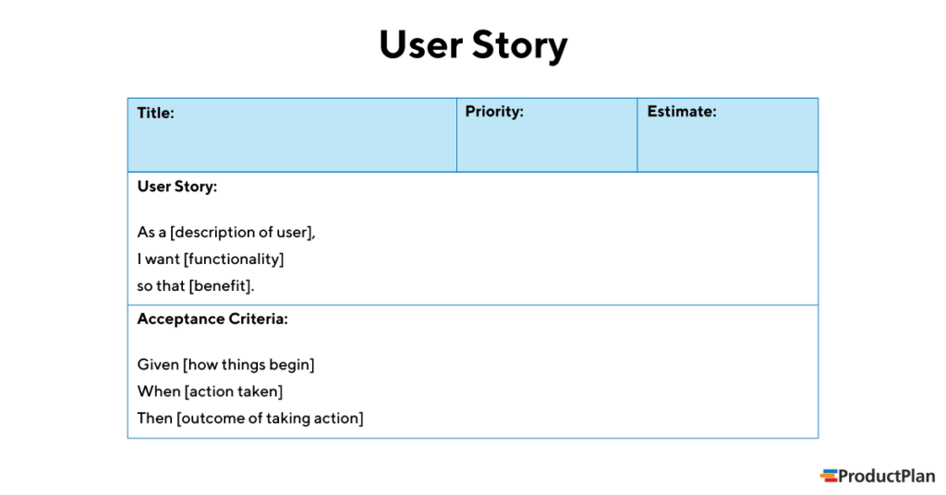
A user story is the smallest unit of work in an agile framework.
A user story is an informal, general explanation of a software feature written from the perspective of the end user or customer

Slide 24
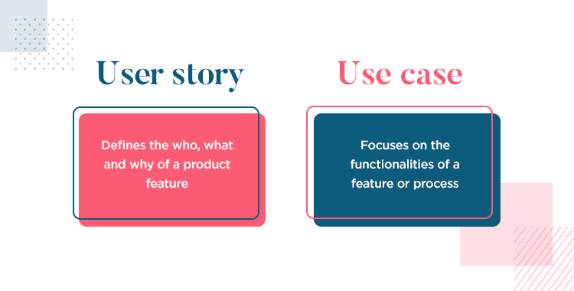

Slide 25
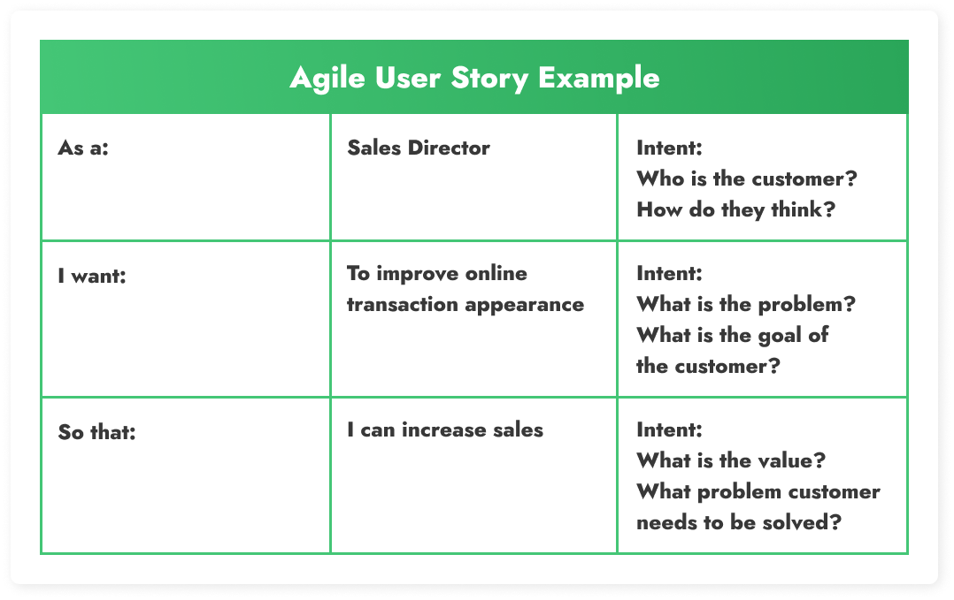

Slide 26
XP Design
Follows the Keep-It-Simple principle.
-Encourage the use of CRC cards(class- responsibility-collaborator) cards identify and organize the object-oriented classes.
-For difficult design problems, suggests the creation of spike solutions — a design prototype.
-Encourages refactoring — an iterative refinement of the internal program design.

Slide 27
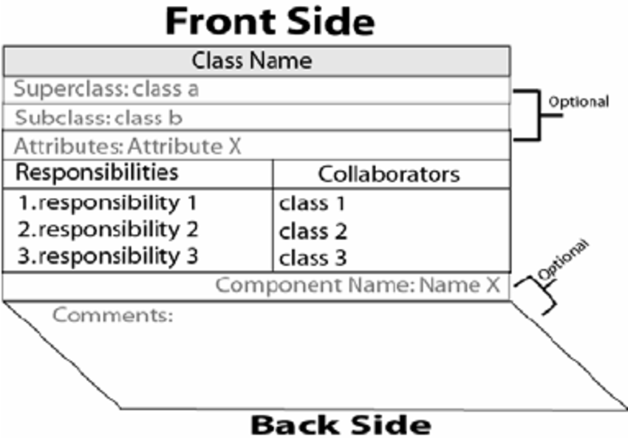
CRC cards

Slide 28
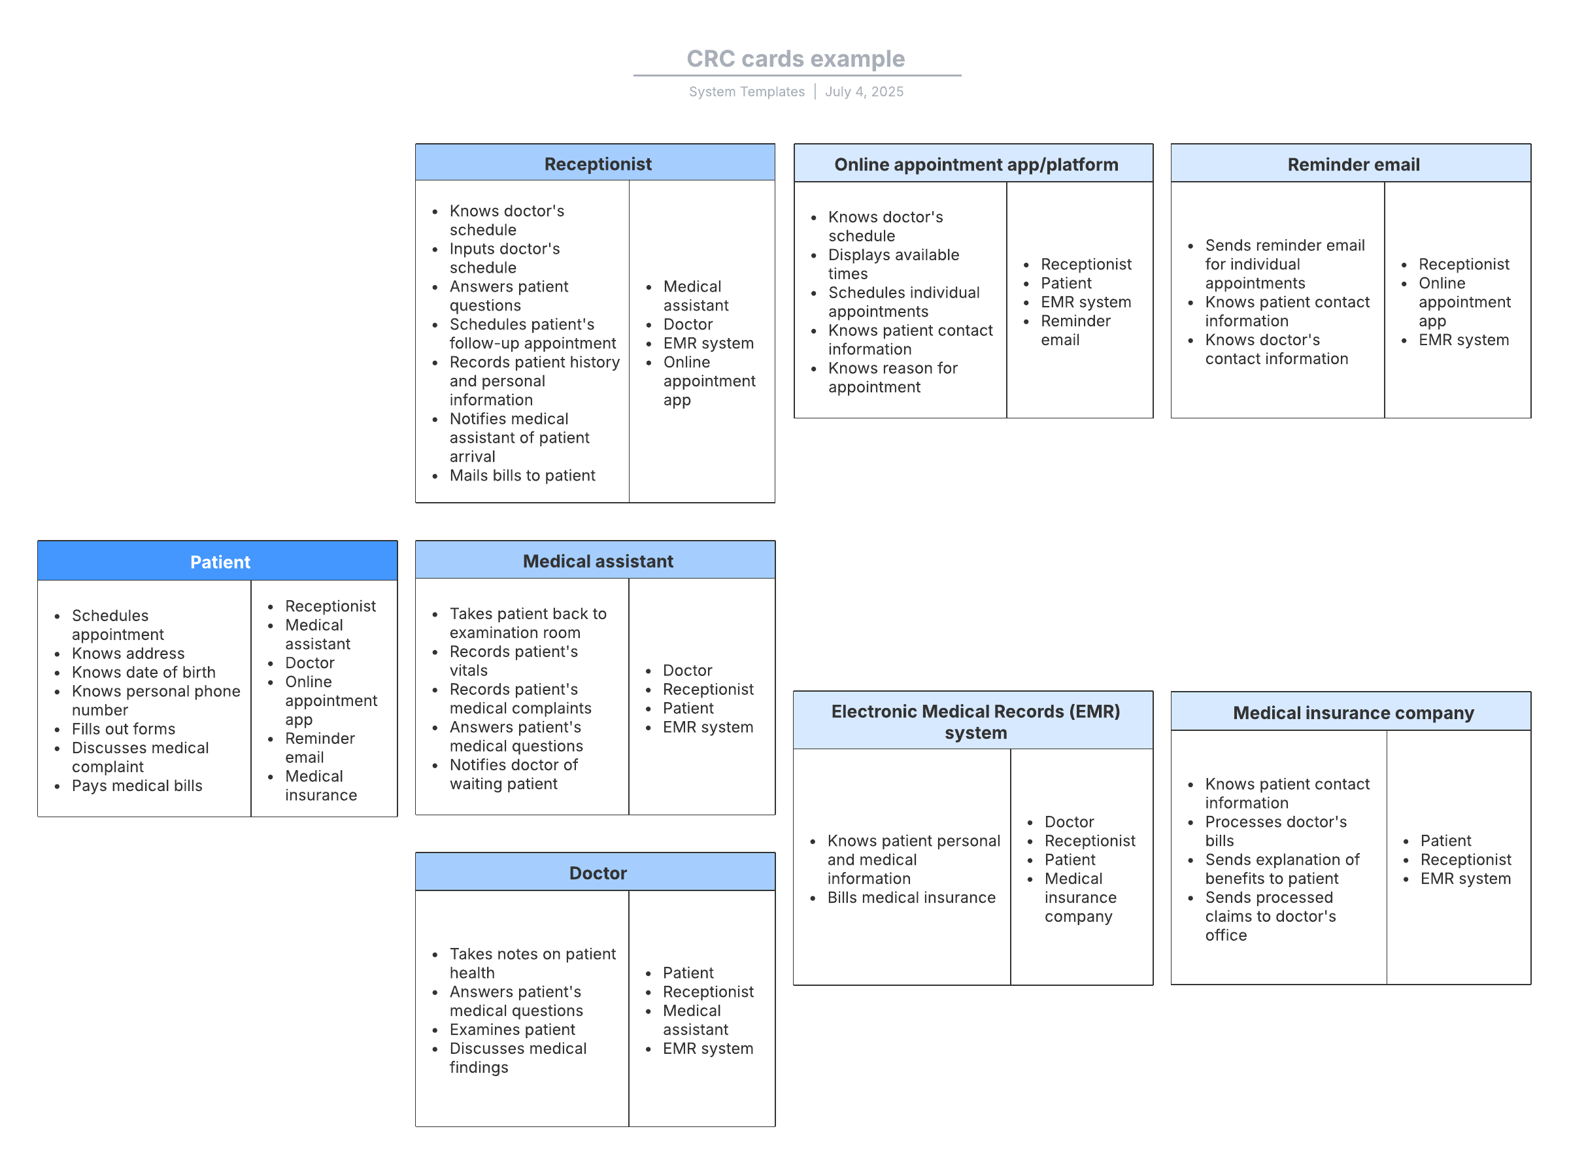

Slide 29
XP Coding
Recommends the construction of a unit test for a story before coding commences.
Encourages pair programming.
XP Testing
All unit tests are executed daily.
Acceptance tests(Customer tests) are defined by the customer and executed to assess customer visible functionality.

Slide 30
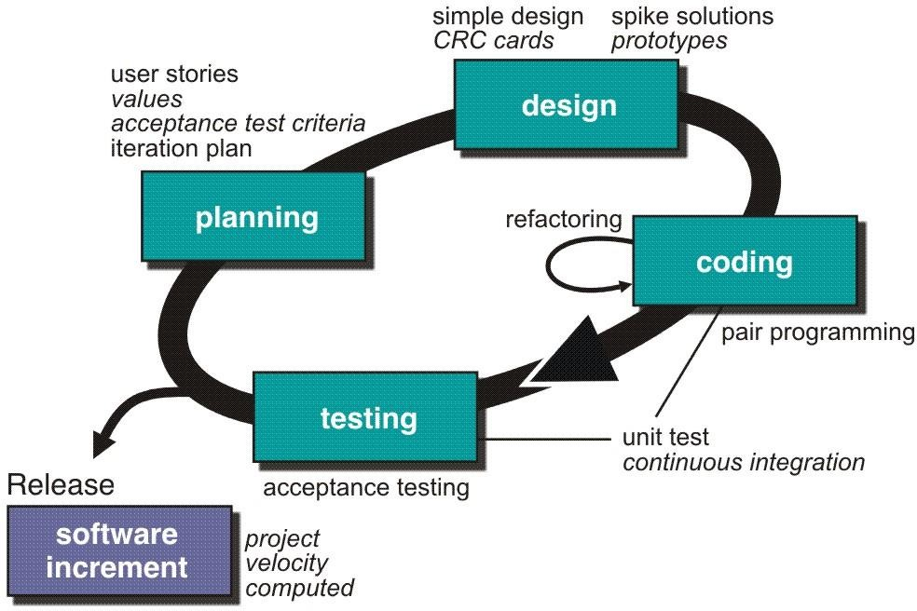

Slide 31
II.Adaptive Software Development (ASD)
Proposed by Jim Highsmith.
technique for building complex s/w and systems.
focus on human collaboration and team self- organization.
ASD life cycle incorporates three phases:
1.speculation,
collaboration, and
learning

Slide 32
1. Speculation:
Project is initiated and adaptive cycle planning is conducted.
Adaptive cycle planning uses
project initiation info—the customer's mission statement, project constraints (e.g., delivery dates or user descriptions),
+
basic requirements—to define the set of release cycles (software increments) that will be required for the project.

Slide 33
2. Collaboration:
Motivated people work together to multiply their talent and creative o/p beyond their absolute numbers.
People working together must trust one another to:
Criticize(find fault) without animosity( enemity, hatred);
Assist without resentment(anger);
work as hard or harder as they do;
have the skill set to contribute to the work at hand; and
communicate problems or concerns in a way that leads to effective action.

Slide 34
3. Learning:
ASD team begin to develop the components that are part of an adaptive cycle, the emphasis is on learning as much as it is on progress toward a completed cycle.
Highsmith argues that s/w developers often over estimate their own understanding (of the technology, the process, and the project) and that learning will help them to improve their level of real understanding.

Slide 35
ASD teams learn in three ways:
1 . Focus groups: customer and/or end-users provide f/b on s/w increments that are being delivered. This provides a direct indication of whether or not the product is satisfying business needs.
Formal technical reviews: Team members review the s/w components that are developed, improving quality and learning as they proceed.
3. Postmortems: Team becomes introspective(self examination), addressing its own performance and process.

Slide 36
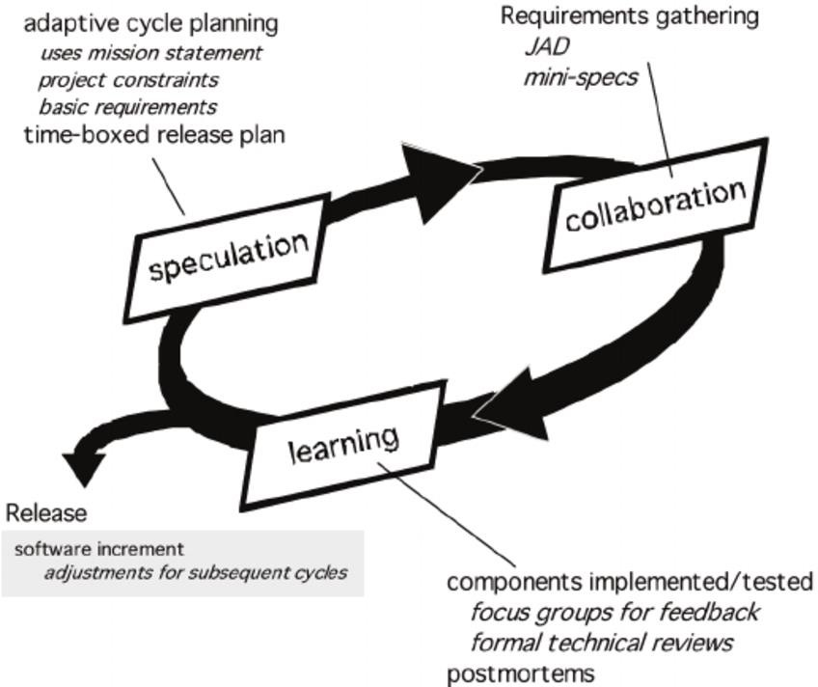
Fig 4.2 ASD(from TB)

Slide 37
III. Dynamic Systems Development Method (DSDM):
Provides a framework for building and maintaining systems which meet tight time constraints through the use of incremental prototyping in a controlled project environment.
Pareto principle- 80% of an application(only enough work is required for each increment to facilitate movement to the next increment) can be delivered in 20% of the time it would take to deliver the complete (100 percent) application.

Slide 38
The Dynamic Systems Development Method (DSDM )
The Dynamic Systems Development Method (DSDM ) provides a framework of controls and best practice for Rapid Application Development (RAD).
(RAD) is a software development methodology that uses minimal planning in support of rapid prototyping.
It is particularly suitable for application development projects that need to develop complex business solutions within tight timeframes.

Slide 39
In DSDM, time is fixed for the life of a project, and resources are fixed as far as possible. This means that it is the requirements that will be satisfied that are allowed to change.
DSDM Eliminate problems of:
Going over-budget
Missing deadlines
Users not involved
Management not committed
Pareto principle -80

Slide 40
DSDM Principles
DSDM is based on nine principles, these are:
1. Active user Involvement is Imperative
2. Teams must be empowered to make their own decisions.
3. Focus on Frequent Delivery
4. Fitness for Business is Criterion for Accepted Deliverables

Slide 41
DSDM Principles ……
5. Iterative development is essential to reach correct solution.
6. Any change during development can be reversed.
7. The most higher-level requirements should be unchangeable.
8. Testing shall occur throughout the lifecycle of the project.
9. All stakeholders must cooperate and communicate.

Slide 42
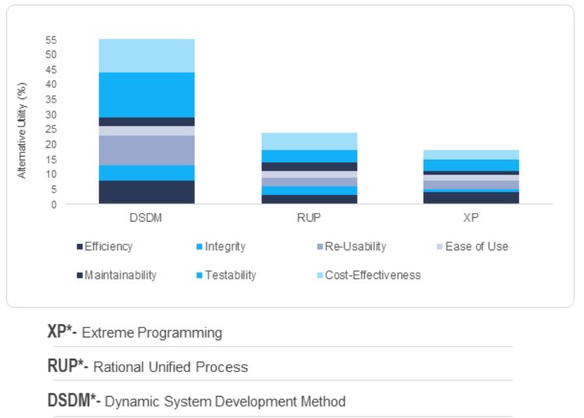

Slide 43
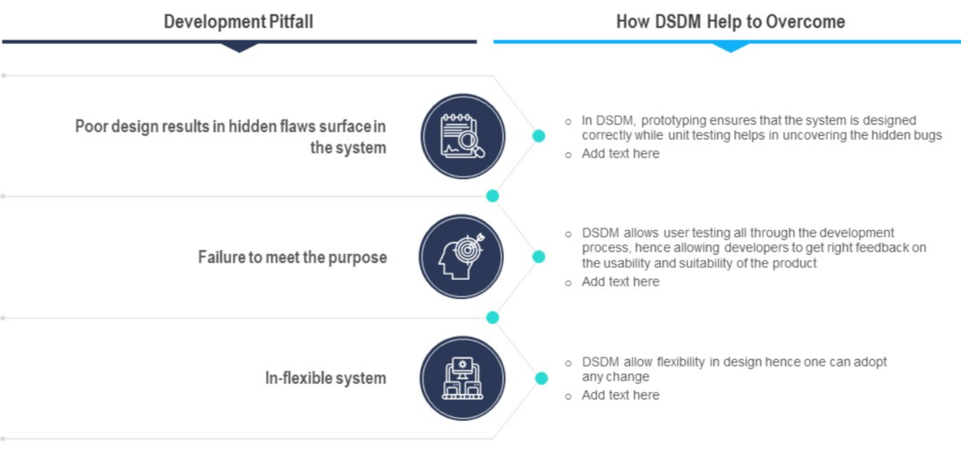

Slide 44
DSDM life cycle:
Defines 3 different iterative cycles, preceded by 2 additional life cycle activities:
1.Feasibility study—establishes the basic business requirements and constraints associated with the application to be built and then assesses whether the application is a viable candidate for the DSDM process.
2.Business study—establishes the functional and information requirements that will allow the application to provide business value;
also, defines the basic application architecture and identifies the maintainability requirements for the application.
3.Functional model iteration—produces a set of incremental prototypes that demonstrate functionality for the customer.
The intent during this iterative cycle is to gather additional requirements by eliciting feedback from users as they exercise the prototype.

Slide 45
4.Design and build iteration— revisits prototypes built during the functional model iteration to ensure that each has been engineered in a manner that will enable it to provide operational business value for end- users.
In some cases, the functional model iteration and the design and build iteration occur concurrently.

Slide 46
5.Implementation—places the latest s/w increment into the operational environment.
It should be noted that:
the increment may not be 100% complete
or
changes may be requested as the increment is put into place.
In either case, DSDM development work continues by returning to the function model iteration activity.

Slide 47
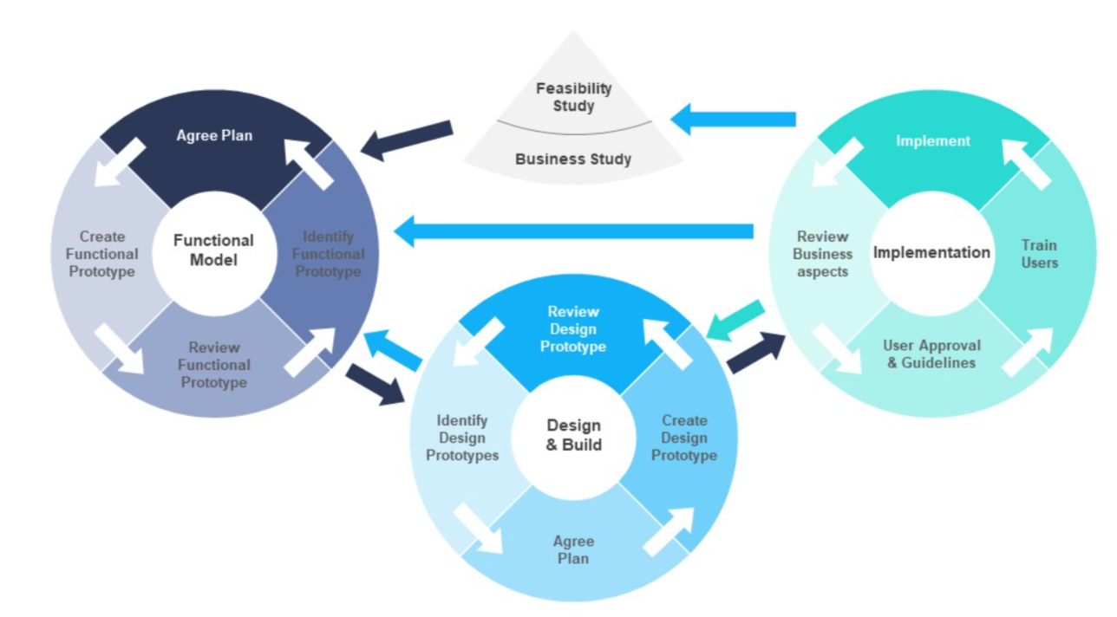
Framework for DSDM development process

Slide 48
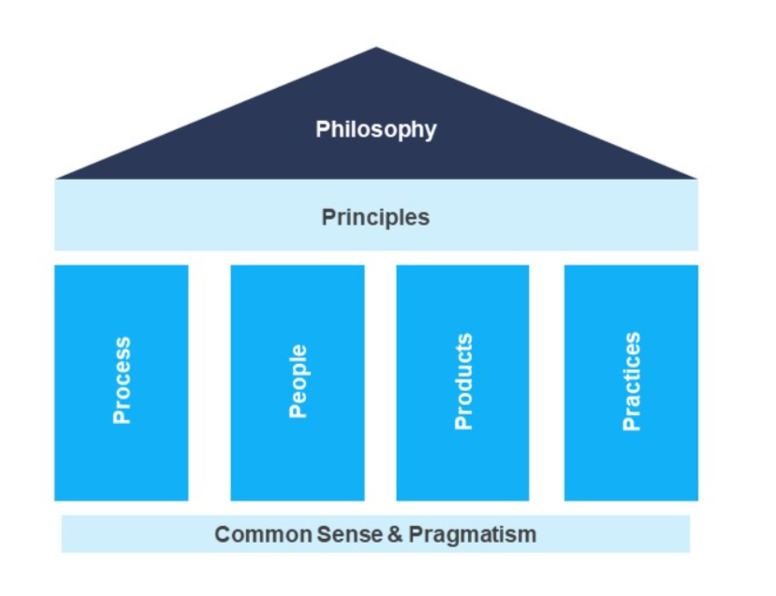
Composition of DSDM framework

Slide 49
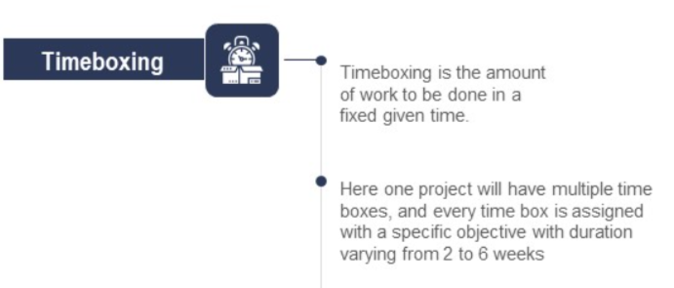
Core tools & techniques for DSDM

Slide 50
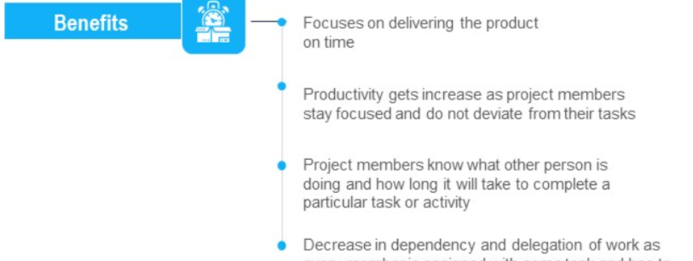
Timeboxing

Slide 51
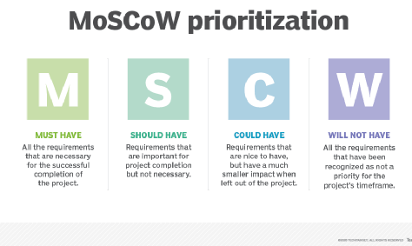
Core tools & techniques for DSDM

Slide 52
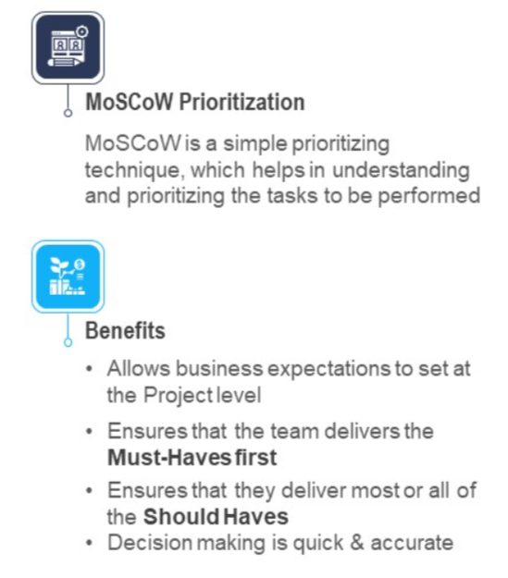

Slide 53
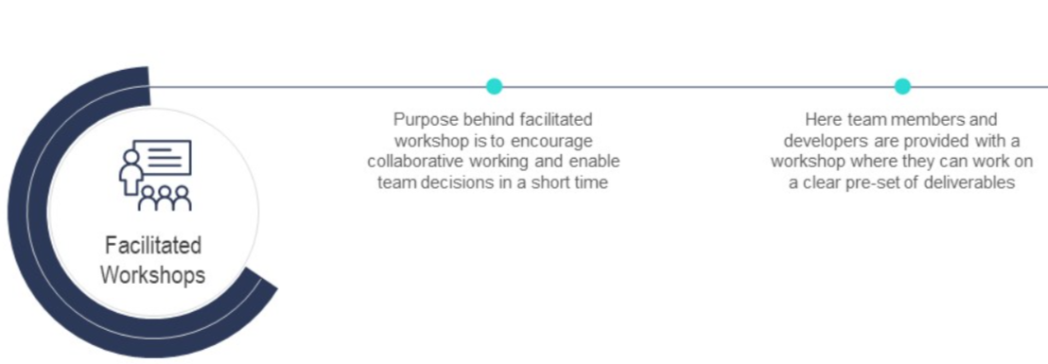
Core tools & techniques for DSDM

Slide 54
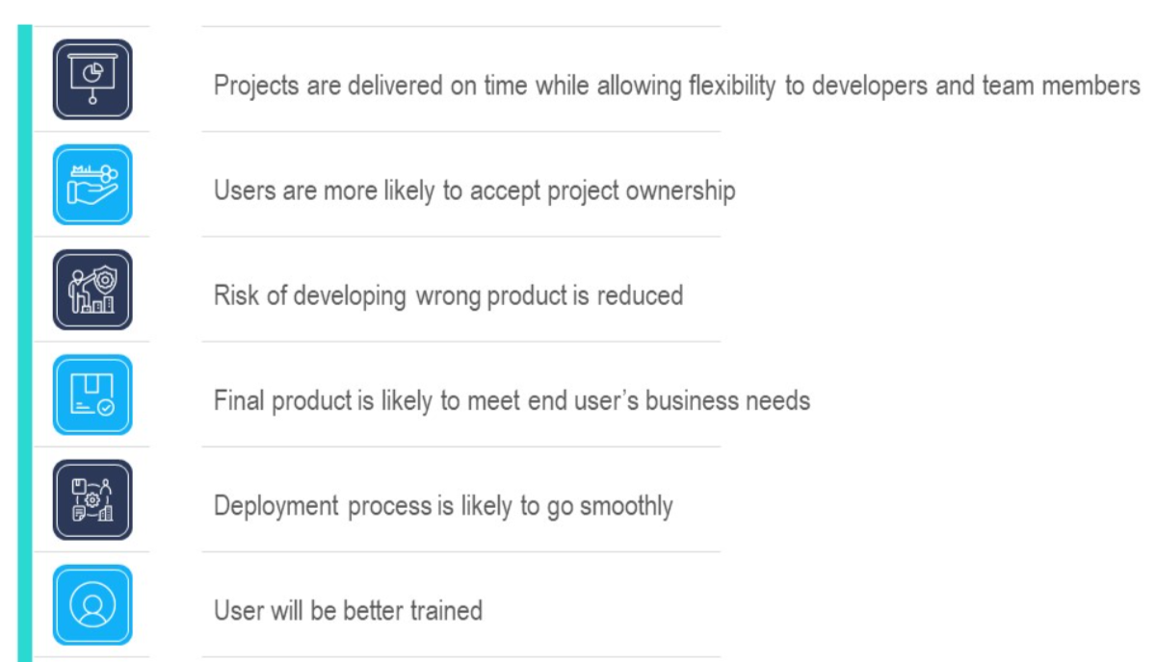
Benefits of Adopting DSDM

Slide 55
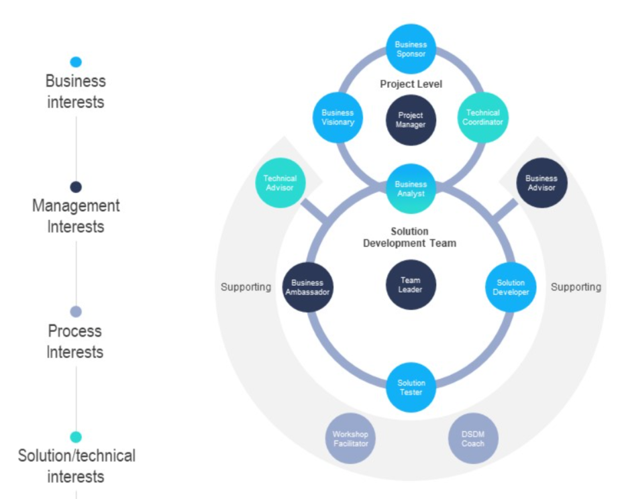
Roles in DSDM

Slide 56
IV. Scrum (name derived from an activity that occurs during a rugby match)
Activity-A group of players forms around the ball and the teammates work together (sometimes violently!) to move the ball downfield.
developed by Jeff Sutherland and his team in the early 1990s.
further development of the Scrum methods has been performed by Schwaber and Beedle.

Slide 57
Scrum principles(6) are consistent (dependable, compatable with the agile manifesto:
1. Small working teams are organized to "maximize communication, minimize overhead, and maximize sharing of tacit, informal knowledge."
2. The process must be adaptable to both technical and business changes "to ensure the best possible product is produced.“
3. The process yields frequent software increments "that can be inspected, adjusted, tested, documented, and built on."

Slide 58
4. Development work and the people who perform it are partitioned "into clean, low coupling partitions, or packets.“
5. Constant testing and documentation is performed as the product is built.
6. The Scrum process provides the "ability to declare a product 'done' whenever required.

Slide 59
Scrum principles are used to guide development activities within a process that incorporates the following framework activities(5):
requirements,
analysis,
design,
evolution, and
delivery.
Within each framework activity, work tasks occur within a process pattern called a sprint.

Slide 60
Backlog—a prioritized list of project requirements or features that provide business value for the customer. Items can be added to the backlog at any time (this is how changes are introduced).
Sprints— work units that are required to achieve a requirement defined in the backlog that must be fit into a predefined time-box (typically 30 days).
During the sprint, the backlog items that the sprint work units address are frozen
(i.e., changes are not introduced during the sprint).

Slide 61
Scrum meetings—are short (typically 15 minutes) meetings held daily by the Scrum team.
Three key questions are asked and answered by all team members:
What did you do since the last team meeting?
What obstacles are you encountering?
What do you plan to accomplish by the next team meeting?
A team leader, called a "Scrum master," leads the meeting and assesses the responses from each person.

Slide 62
Demos—deliver the s/w increment to the customer so that functionality that has been implemented can be demonstrated and evaluated by the customer.

Slide 63
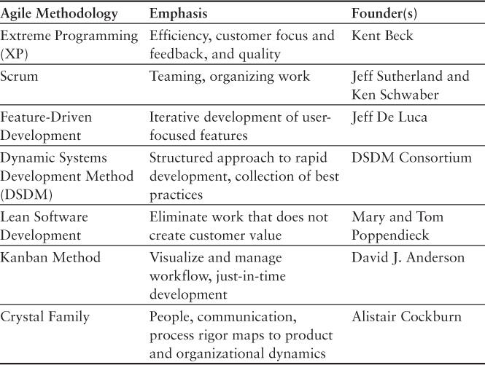

Slide 64
Feature Driven Development (FDD)
Feature Driven Development (FDD) is an agile software development methodology focused on building and designing software by breaking it down into features. It’s especially effective for large-scale projects and teams.

Slide 65
FDD-Characteristics
Feature-centric: Development revolves around small, client-valued features.
Model-driven: Begins with creating a domain model.
Iterative and incremental: Short cycles (1–3 weeks) ensure frequent updates.
Scalable: Suitable for large teams and complex systems.
Progress tracking: Reporting is emphasized at all levels.

Slide 66
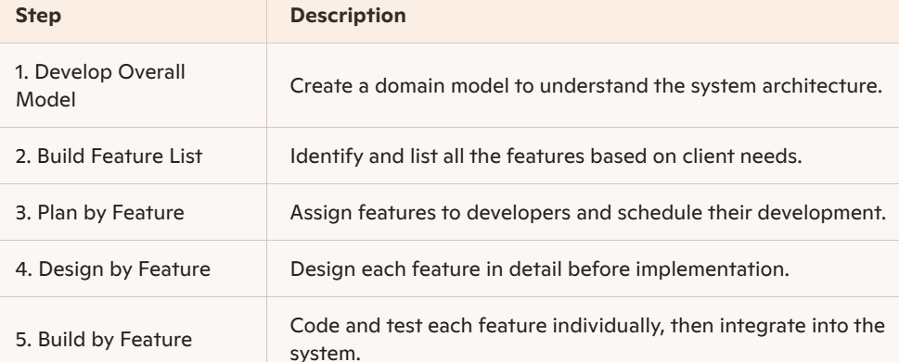
FDD Life Cycle Phases

Slide 67
FDD-Advantages
Clear visibility of progress through feature tracking.
Frequent releases improve client satisfaction.
Reduces risk by focusing on small, manageable units.
Better cost estimation due to feature segmentation.

Slide 68
FDD-Disadvantages
Not ideal for small projects.
High dependency on experienced lead developers.
Limited documentation may cause issues later.

